Slide 1
Why Use FHIR® Terminology Services?
Rob Hausam MD
HL7 India FHIR Connectathon

Slide 2
Who am I?
Name: Rob Hausam MD
Company: Hausam Consulting LLC
Background:
Co-chair of Vocabulary and Orders and Observations WGs
FHIR specification and Terminology Module editor
Actively involved in HL7 and terminology standards/development and modeling for 18+ years
SNOMED on FHIR project co-lead
Joint project of HL7 and SNOMED International

Slide 3
where to find Terminology in FHIR

Slide 4
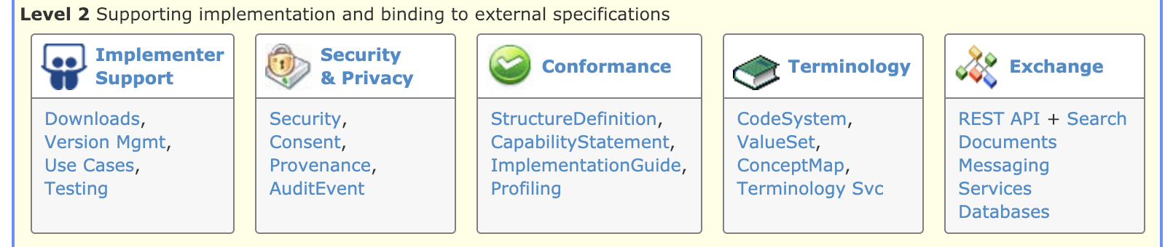
Terminology Module
Level 2 on the Home page
The primary organizing place in the FHIR specification for terminology specifications, guidance and content
http://hl7.org/fhir/terminology-module.html

Slide 5
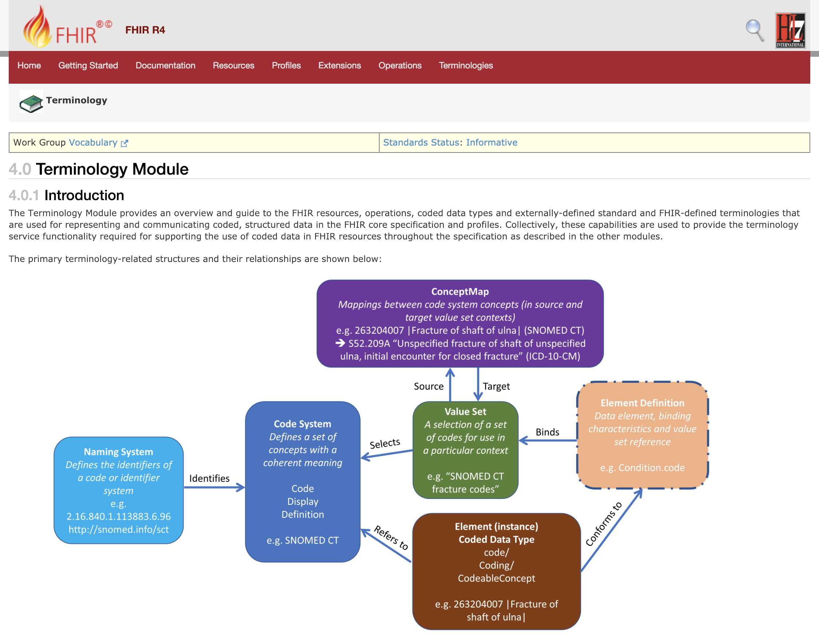

Slide 6

Terminologies link
Terminologies link
The last link on the right in the top-level (red) navigation bar
The quick and easy way to get to the terminology content in the FHIR specification – code systems, value sets, concept maps

Slide 7
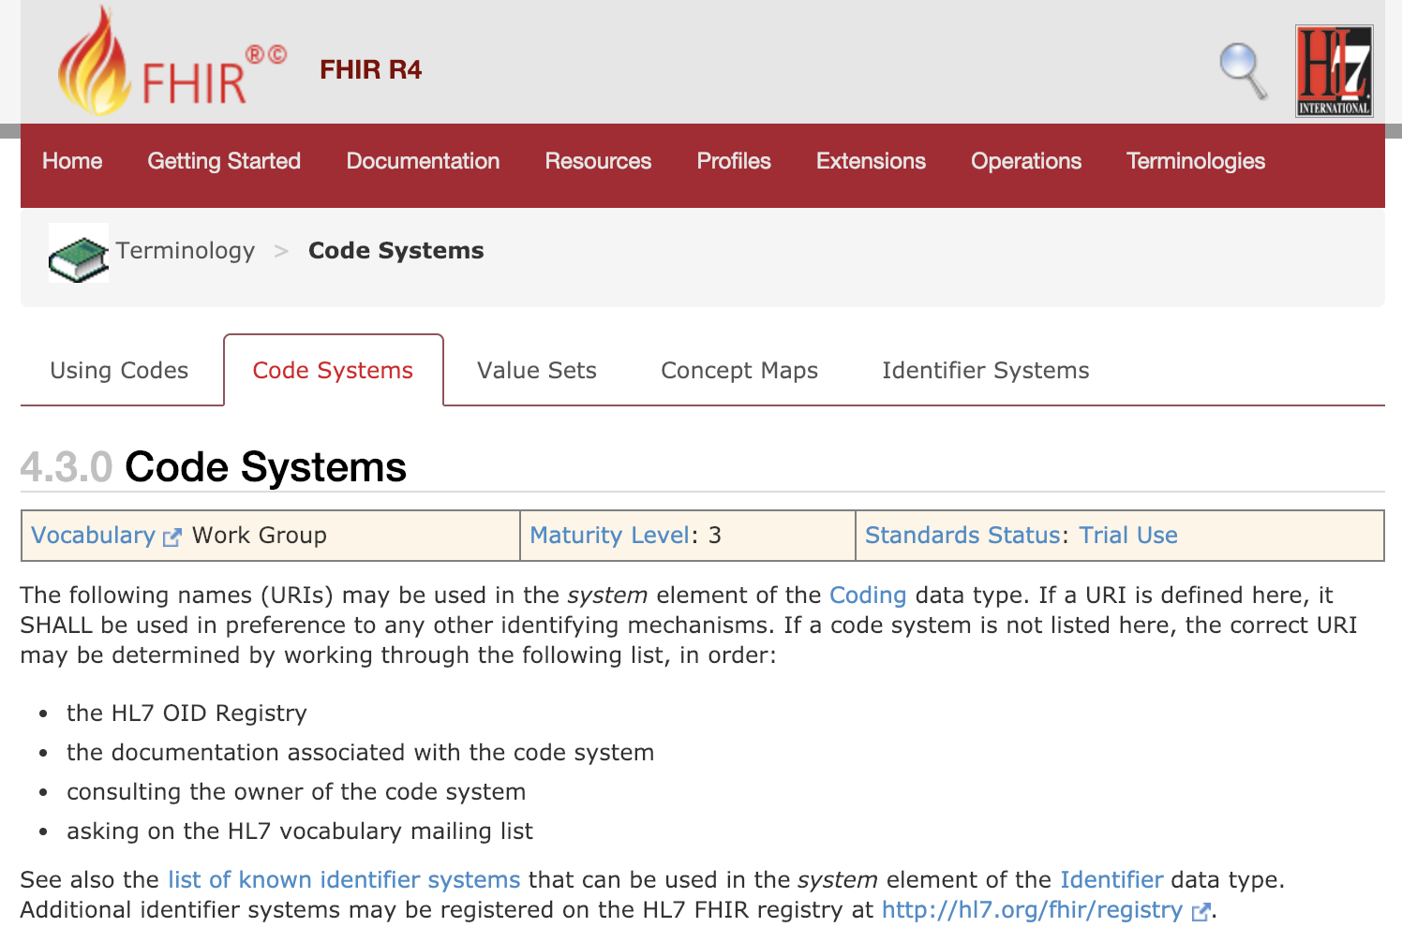

Slide 8
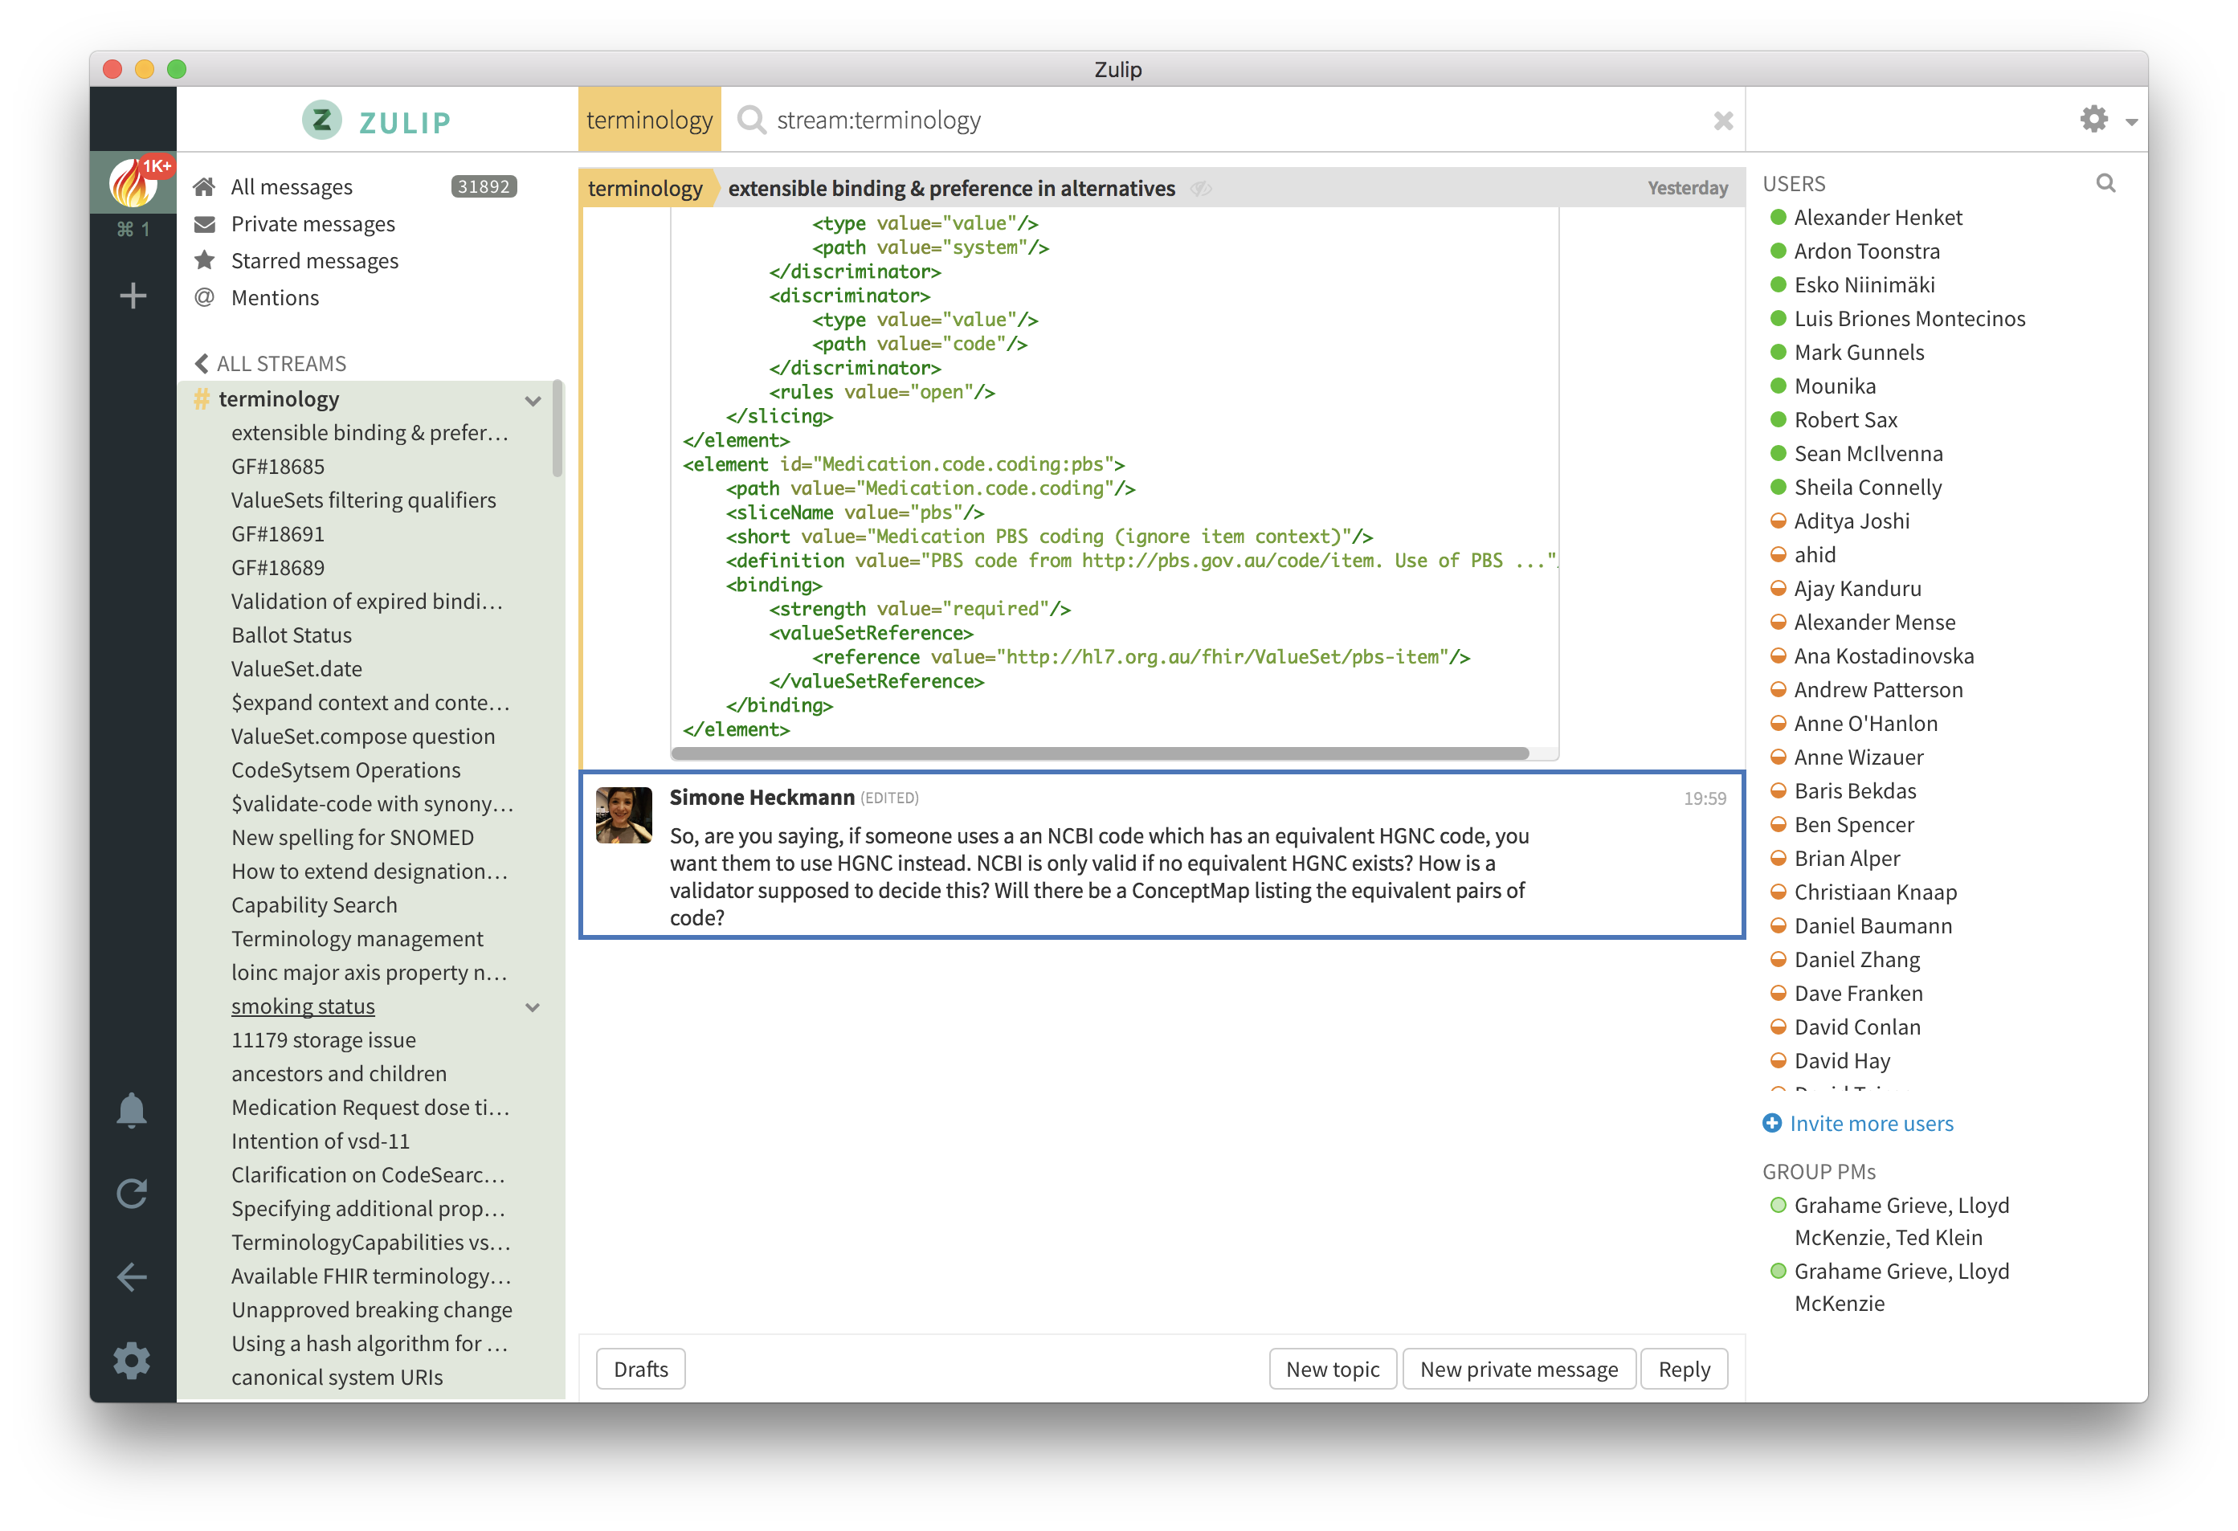
FHIR Zulip chat Terminology stream
https://chat.fhir.org/#narrow/stream/terminology

Slide 9
Representing Coded Data in fhir

Slide 10
Coded Data Types
‘code’
Just a code!
CodeSystem is fixed by the underlying Resource
‘Coding’
system, version, code, display, userSelected
CodeableConcept
Codings (..*) plus text

Slide 11
Code System vs. Value Set
Code systems define symbols with specific meanings
E.g. LOINC, SNOMED, ICD-10, IETF language codes, local lab result codes, etc.
Value sets define collections of codes for use in a particular context
E.g. Codes for vital signs, codes for procedures
Can come from a single code system or multiple code systems

Slide 12
Coded Data – The Big Picture
Value Set
A selection of a set of codes for use in a particular context
e.g. “SNOMED CT fracture codes”
Element Definition Data element, binding characteristics and value set reference e.g. Condition.code
Code System
Defines a set of concepts with a coherent meaning Code Display
Definition
e.g. SNOMED CT
Selects
Binds
Element (instance)
Coded Data Type code/ Coding/ CodeableConcept e.g. 263204007 |Fracture of shaft of ulna|
Conforms to
Refers to
No reference from a coded data instance directly to a value set (except by the valueset-reference extension)
12

Slide 13
Binding vs. Data element instance
A binding specifies a value set
Observation.code is bound to:
valueSetReference = http://hl7.org/fhir/ValueSet/observation-codes
Definition of ‘observation-codes’ = “This value set includes all LOINC codes”
A data element instance specifies a code system
Observation.code.coding.system = http://loinc.org
Observation.code.coding.code = 15074-8
Observation.code.coding.display = Glucose [Moles/volume] in Blood

Slide 14
Terminology SERVICEs

Slide 15
Terminology Service Rationale
There’s a lot of complexity here:
Code Systems
Value Sets
Bindings
Many (or most) applications are much simpler
List of codes and displays in some table structure
This is a known problem

Slide 16
Terminology Service Rationale
Delegate the complexity to specialist software
Provide a set of services that do what applications need
It becomes easy to write applications that do terminology well

Slide 17
Application Needs
Give me a list of codes
e.g., to populate my dropdown list
Is this code valid?
e.g., is the code that I received from an outside source a member of the required value set?
How do I display a code?
e.g., I need to show the preferred display term for my application context

Slide 18
Application Needs
Translate this code to a different code system
e.g., I coded the diagnosis in SNOMED CT and now I need to submit the claim in ICD-10
Integrate terminology search into my application
e.g., my type-ahead search to enter data into the allergy list needs the value set expansion for the list of codes that should be included

Slide 19
Terminology Service Operations – Overview (Details Later)
ValueSet
$expand
$validate-code
CodeSystem
$lookup
$subsumes
$find-matches
$validate-code
ConceptMap
$translate
$closure
Renamed in R4 – previously $compose
The operation was already included in ValueSet, but is also a new addition for CodeSystem in R4

Slide 20
Scenarios and strategies for using Terminology serviceS

Slide 21
Data entry interface
Choose code systems (ideally standard)
Choose or define value sets
For small value sets, populate a picklist using $expand
For large value sets, may use $expand?filter=xxx for type-ahead search

Slide 22
Creating a profile
Choose or define the code systems and value sets
Determine the binding strength
Set up the code system and value set maintenance and update processes
Concepts can become deprecated over time – watch for this!
You may be able to use ConceptMaps to find the concepts that have changed

Slide 23
Analyzing or validating coded data
Choose or define the code systems and value sets
Use $validate-code to check whether the codes are valid in your context, and whether the display text is correct
Clinical systems often allow users to change the display term
Use $translate to map local or non-standard coded data to the standard code systems / value sets for analysis
You may want to use an inline ValueSet with $subsumes or $validate-code (or $closure) for categorizing data

Slide 24
Exploring concept relationships
You can use $lookup to retrieve the properties and display them in a table (or other useful format)
You can navigate the hierarchy between concepts using the ‘child’ and ‘parent’ properties or by $subsumes (or $closure)

Slide 25
References for Servers and tools

Slide 26
Some Publicly Available Terminology Servers
Health Intersections (Grahame Grieve)
http://tx.fhir.org/r3
http://tx.fhir.org/r4
HAPI (University Health Network – James Agnew)
http://fhirtest.uhn.ca/home?serverId=home_21&pretty=true
http://fhirtest.uhn.ca/home?serverId=home_r4&pretty=true
OntoServer (CSIRO – Australia – Michael Lawley)
https://ontoserver.csiro.au/
https://r4.ontoserver.csiro.au/fhir

Slide 27
Some Publicly Available Terminology Servers
Value Set Authority Center (VSAC) – US National Library of Medicine (NLM)
https://cts.nlm.nih.gov/fhir/
Terminz (Patients First – New Zealand – Peter Jordan)
https://terminz.azurewebsites.net/fhir
Link to other publicly available FHIR servers (general and terminology)
https://confluence.hl7.org/display/FHIR/Test+Servers

Slide 28
Some Useful Tools
clinFHIR (David Hay)
CodeSystem builder
http://clinfhir.com/codeSystem.html
ValueSet editor
http://clinfhir.com/valuesetCreator.html
Query Tool
http://clinfhir.com/query.html
Postman
https://www.getpostman.com/

Slide 29
Some Useful Tools (cont.)
Shrimp SNOMED CT browser (CSIRO)
http://ontoserver.csiro.au/shrimp
CSIRO Value Set $expand Comparison Tool
http://ontoserver.csiro.au/vstool
FHIR Tools release page
http://www.healthintersections.com.au/FhirServer/

Slide 30
Questions?
Connect with the FHIR community: FHIR Zulip chat terminology stream
https://chat.fhir.org/#narrow/stream/terminology
Or ask me: Rob Hausam
rob@hausamconsulting.com

